Slide 1
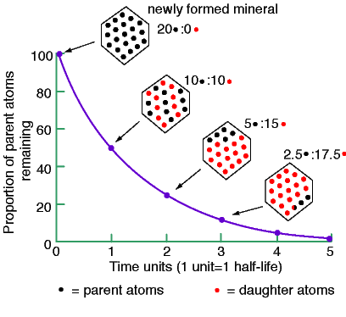
CHEM 702: Lecture 6 Radioactive Decay Kinetics Part 1
Outline
Readings: Modern Nuclear Chemistry Chapter 3; Nuclear and Radiochemistry Chapters 4 and 5
Radioactive decay kinetics
Basic decay equations
Utilization of equations
Mixtures
Equilibrium
Branching
Natural radiation
Dating

Slide 2
Introduction to Radioactive Decay
Number of radioactive nuclei that decay in radioactive sample decreases with time
Exponential decrease
Independent of P, T, mass action and 1st order
Conditions associated with chemical kinetics
Electron capture and internal conversion can be affected by conditions
Specific for isotope and irreversible
Decay of given radionuclide is random
Decay rate proportional to amount of parent isotope
rate of decay=decay constant*# radioactive nuclei
A= λΝ
Decay constant is average decay probability per nucleus for a unit time
Represented by λ

Slide 3
Basic decay equations
Probability of disintegration for a given radioactive atom in a specific time interval is independent past history and present circumstances
Probability of disintegration depends only on length of time interval
Probability of decay: p=λΔt
Probability of not decaying: 1-p=1- λΔt
(1-λ Δt)^{n}=probability that atom will survive n intervals of Δt
nΔt=t, therefore (1- λ Δt)^{n} =(1- λ t/n)^{n}
lim_{n→∞}(1+x/n)^{n}=e^{x}, (1-λt/n)^{n}=e^{-λt} is limiting value
Considering N_{o} initial atoms
fraction remaining unchanged after time t is
N/N_{o}= e^{-λt}
N is number of atoms remaining at time t
N=N_{o}e^{-λt}

Slide 4
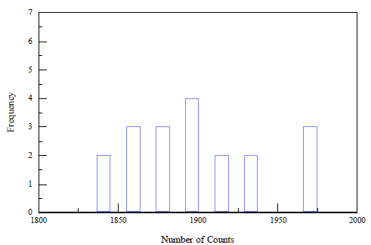
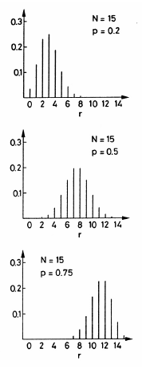
Radioactivity as Statistical Phenomenon: Binomial Distribution
Radioactive decay a random process
Number of atoms in a given sample that will decay in a given Δt can differ
Neglecting same Δt over large time differences, where the time difference is on the order of a half life
Relatively small Δt in close time proximity
Binomial Distribution for Radioactive Disintegrations
Reasonable model to describe decay process
Bin counts, measure number of occurrences counts fall in bin number
Can be used as a basis to model radioactive case
Classic description of binomial distribution by coin flip
Probability P(x) of obtaining x disintegrations in bin during time t, with t short compared to t_{1/2}
n: number of trials
p: probability of event in bin

Slide 5
Radioactivity as Statistical Phenomenon: Error from Counting
For radioactive disintegration
Probability of atom not decaying in time t, 1-p, is (N/N_{o})=e^{-λt}
p=1-e^{-λt}
N is number of atoms that survive in time interval t and N_{o} is initial number of atoms
Time Intervals between Disintegrations
Distribution of time intervals between disintegrations
t and t+d
Write as P(t)dt

Slide 6
Decay Statistics
Average disintegration rate
Average value for a set of numbers that obey binomial distribution
Use n rather than N_{o}, replace x (probability) with r (disintegrations)
Average value for r
Solve using binomial expansion
Then differentiate with respect to x

Slide 7
Decay Statistics
Let x=1
Related to number and probability
For radioactive decay n is N_{o} and p is (1-e^{-λt})
Use average number of atoms disintegrating in time t
M=average number of atoms disintegrating in time t
Can be measured as counts on detector
M=N_{o}(1-e^{-λt})
For small λt, M=N_{o}λt
Disintegration rate is M per unit time
R=M/t=N_{o}λ
Small λt means count time is short compared to half life
Corresponds to -dN/dt=λN=A

Slide 8
Decay Statistics
Expected Standard Deviation
Base on expected standard deviation from binomial distribution
Use binomial expansion
and differentiate with respect to x
x=1 and p+(p-1)= 1
Variation defined as
Combine
From bottom of slide 3-6

Slide 9
Expected Standard Deviation
Solve with:
Apply to radioactive decay
M is the number of atoms decaying
Number of counts for a detector
Relative error = σ⁻¹
What is a reasonable number of counts
More counts, lower error
Counts | error | % error
10 | 3.16 | 31.62
100 | 10.00 | 10.00
1000 | 31.62 | 3.16
10000 | 100.00 | 1.00

Slide 10
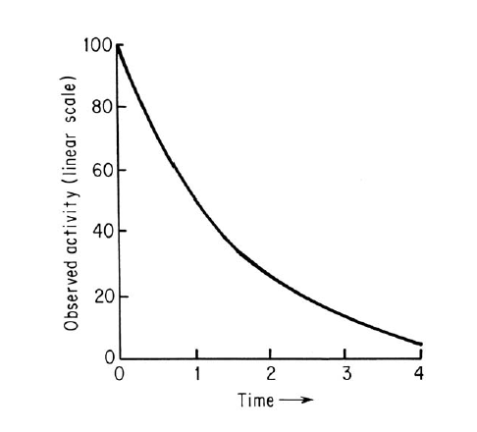
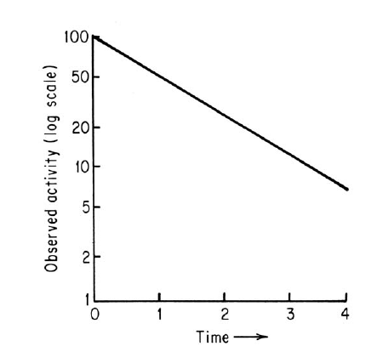
Measured Activity
Activity (A) determined from measured counts by correcting for geometry and efficiency of detector
Not every decay is observed
Convert counts to decay
A= λN
A=A_{o}e^{-λt}
Units
Curie
3.7E10 decay/s
1 g ²²⁶Ra
A= λN
Becquerel
1 decay/s

Slide 11
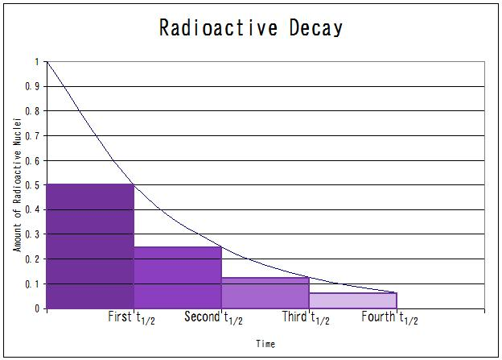
Half Life and Decay Constant
Half-life is time needed to decrease nuclides by 50%
Relationship between t_{1/2} and λ
N/N_{o}=1/2=e^{-λt}
ln(1/2)=-λt_{1/2}
ln 2= λt_{1/2}
t_{1/2}=(ln 2)/λ
Large variation in half-lives for different isotopes
Short half-lives can be measured
Evaluate activity over time
Observation on order of half-life
Long half-lives
Based on decay rate and sample
Need to know total amount of nuclide in sample
A=λN

Slide 12
Exponential Decay
Average Life (τ) for a radionuclide
found from sum of times of existence of all atoms divided by initial number of nuclei
1/λ=1/(ln2/t_{1/2})=1.443t_{1/2}=τ
Average life greater than half life by factor of 1/0.693
During time 1/λ activity reduced to 1/e it’s initial value
Total number of nuclei that decay over time
Dose
Atom at a time

Slide 13
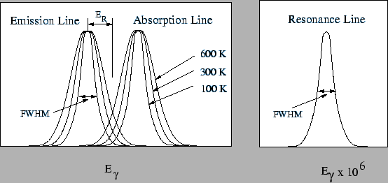
Gamma decay and Mossbauer Spectroscopy
Couple with Heisenberg uncertainty principle
ΔE Δt≥h/2π
Δt is τ, with energy in eV
ΔE≥(4.133E-15 eV s/2π)/τ= Γ
Γ is decay width
Resonance energy
Γ(eV)=4.56E-16/t_{1/2}
t_{1/2} in seconds
t_{1/2}=1 sec, τ=1.44 s
Need very short half-lives for large widths
Useful in Moessbauer spectroscopy
Absorption distribution is centered around E_{γ}+ΔE
emission centered E_{γ}−ΔE .
overlapping part of the peaks can be changed by changing temperature of source and/or absorber
Doppler effect and decay width result in energy distribution near E_{r}
Doppler from vibration of source or sample

Slide 14
Important Equations!
N_{t}=N_{o}e^{-λt}
N=number of nuclei, λ= decay constant, t=time
Also works for A (activity) or C (counts)
A_{t}=A_{o}e^{-λt}, C_{t}=C_{o}e^{-λt}
A= λN
1/λ=1/(ln2/t_{1/2})=1.443t_{1/2}=τ
Error
M is number of counts

Slide 15
Half-life calculation
Using N_{t}=N_{o}e^{-λt}
For an isotope the initial count rate was 890 Bq. After 180 minutes the count rate was found to be 750 Bq
What is the half-life of the isotope
750=890exp(-λ*180 min)
750/890=exp(-λ*180 min)
ln(750/890)= -λ*180 min
-0.171/180 min= -λ
9.5Ε−4 min⁻¹ =λ=ln2/t_{1/2}
t_{1/2}=ln2/9.5E-4=729.6 min

Slide 16
Half-life calculation
A=λN
A 0.150 g sample of ²⁴⁸Cm has a alpha activity of 0.636 mCi.
What is the half-life of ²⁴⁸Cm?
Find A
0.636 E-3 Ci (3.7E10 Bq/Ci)=2.35E7 Bq
Find N
0.150 g x 1 mole/248 g x 6.02E23/mole= 3.64E20 atoms
λ=A/N= 2.35E7 Bq/3.64E20 atoms=6.46E-14 s⁻¹
t_{1/2}=ln2/λ=0.693/6.46E-14 s⁻¹=1.07E13 s
1.07E13 s=1.79E11 min=2.99E9 h=1.24E8 d =3.4E5 a

Slide 17
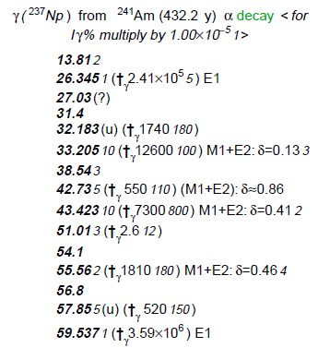
Counting
A=λN
Your gamma detector efficiency at 59 keV is 15.5 %. What is the expected gamma counts from 75 micromole of ²⁴¹Am?
Gamma branch is 35.9 % for ²⁴¹Am
C=(0.155)(0.359)λN
t_{1/2}=432.7 a* (3.16E7 s/a)=1.37E10 s
λ=ln2/1.37E10 s=5.08E-11 s⁻¹
N=75E-6 moles *6.02E23/mole=4.52E19 atoms
C=(0.155)(0.359)5.08E-11 s⁻¹*4.52E19 =1.28E8 counts/second

Slide 18
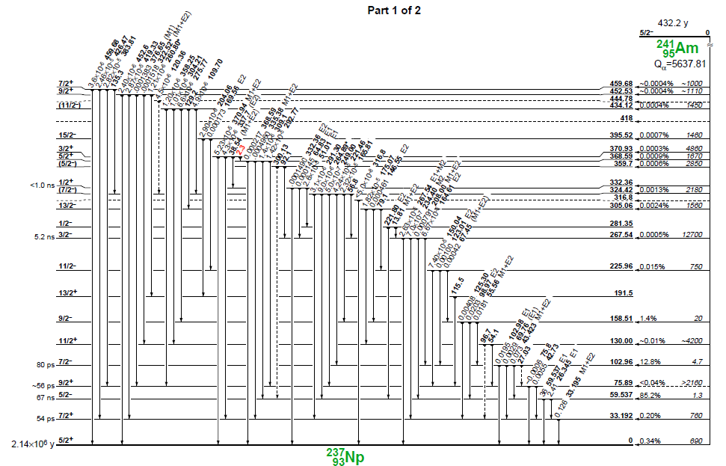
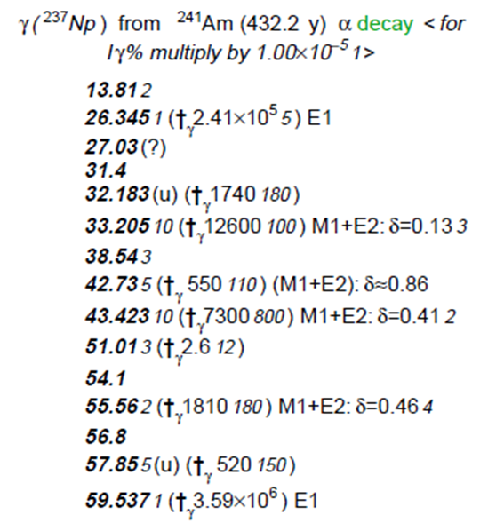
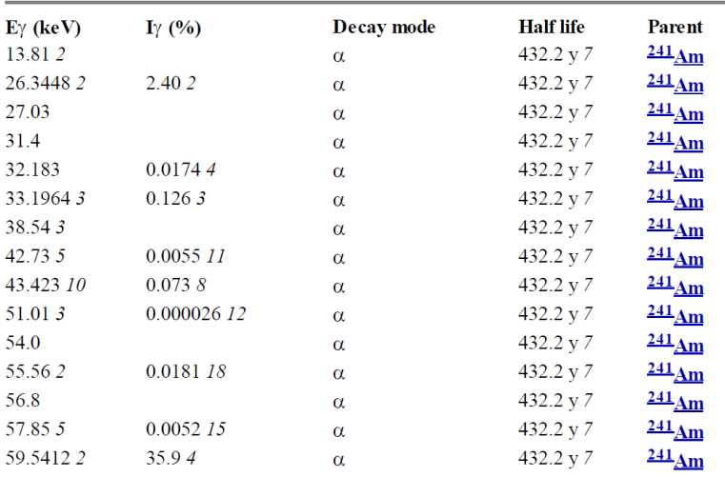
Decay Scheme

Slide 19
Specific activity
Activity of a given amount of radionuclide
Use A=λN
Use of carrier should be included
SA of ²²⁶Ra
1 g ²²⁶Ra, t_{1/2}= 1599 a
1 g * 1 mole/226 g * 6.02E23 atoms/mole = 2.66E21 atom = N
t_{1/2}=1599 a *3.16E7 s/a = 5.05E10 s
λ=ln2/ 5.05E10 s =1.37E-11 s⁻¹
A= 1.37E-11 s⁻¹ * 2.66E21=3.7E10 Bq
Definition of a Curie!

Slide 20
Specific Activity
1 g ²⁴⁴Cm, t_{1/2}=18.1 a
1 g * 1 mole/244 g * 6.02E23 atoms/mole = 2.47E21 atom = N
t_{1/2}=18.1 a *3.16E7 s/a = 5.72E8 s
λ=ln2/ 5.72E8 s =1.21E-9 s⁻¹
A= 1.21E-9 s⁻¹ * 2.47E21=2.99E12 Bq
Generalized equation for 1 g
6.02E23/Isotope mass *2.19E-8/ t_{1/2} (a)
1.32E16/(Isotope mass* t_{1/2} (a))
Isotope |  | t _{1/2} (a) | SA (Bq/g)
14 | C | 5715 | 1.65E+11
228 | Th | 1.91E+00 | 3.03E+13
232 | Th | 1.40E+10 | 4.06E+03
233 | U | 1.59E+05 | 3.56E+08
235 | U | 7.04E+08 | 7.98E+04
238 | U | 4.47E+09 | 1.24E+04
237 | Np | 2.14E+06 | 2.60E+07
238 | Pu | 8.77E+01 | 6.32E+11
239 | Pu | 2.40E+04 | 2.30E+09
242 | Pu | 3.75E+05 | 1.45E+08
244 | Pu | 8.00E+07 | 6.76E+05
241 | Am | 4.33E+02 | 1.27E+11
243 | Am | 7.37E+03 | 7.37E+09
244 | Cm | 1.81E+01 | 2.99E+12
248 | Cm | 3.48E+05 | 1.53E+08

Slide 21
Specific Activity
Activity/mole
N=6.02E23
SA (Bq/mole) of ¹²⁹I, t_{1/2}=1.57E7 a
t_{1/2}=1.57E7 a *3.16E7 s/a = 4.96E14 s
λ=ln2/ 4.96E14 s =1.397E-15 s⁻¹
A= 1.397E-15 s⁻¹ *6.02E23=8.41E8 Bq
Generalized equation
SA (Bq/mole)=1.32E16/t_{1/2} (a)

Slide 22
Specific activity with carrier
1E6 Bq of ¹⁵²Eu is added to 1 mmole Eu.
Specific activity of Eu (Bq/g)
Need to find g Eu
1E-3 mole *151.96 g/mole = 1.52E-1 g
=1E6 Bq/1.52E-1 g =6.58E6 Bq/g
=1E9 Bq/mole
What is SA after 5 years
t_{1/2}=13.54 a
= 6.58E6*exp((-ln2/13.54)*5)=
5.09E6 Bq/g

Slide 23
Lifetime
Atom at a time chemistry
²⁶¹Rf lifetime
Find the lifetime for an atom of ²⁶¹Rf
t_{1/2} = 65 s
τ=1.443t_{1/2}
τ=93 s
Determines time for experiment
Method for determining half-life

Slide 24
Mixtures of radionuclides
Composite decay
Sum of all decay particles
Not distinguished by energy
Mixtures of Independently Decaying Activities
if two radioactive species mixed together, observed total activity is sum of two separate activities:
A_{t}=A₁+A₂=λ₁N₁+λ₂N₂
any complex decay curve may be analyzed into its components
Graphic analysis of data is possible
λ=0.554 hr⁻¹
t_{1/2}=1.25 hr
λ=0.067 hr⁻¹
t_{1/2}=10.4 hr

